Slide 1
Introduction to Data Science
Daniel Gutierrez, Data Scientist
Los Angeles, Calif.
Notes:
Welcome to the Introduction to Data Science course offered by UCLA Extension.

Slide 2
Course Outcomes
Explore supervised machine learning for prediction
How to use the linear model in R
How to use R for classification problems using logistic regression and Random Forest
Notes:
This is WEEK 9 of the Introduction to Data Science course offered by UCLA Extension. This module covers supervised machine learning materials.

Slide 3
Lesson Objectives
Be able to employ supervised machine learning using – linear regression and classification
Using the lm() algorithm in R
Using the glm() algorithm in R
Using the randomForest() algorithm in R
Training the model to obtain coefficients
Making predictions using the trained model and test set
Measuring performance of the model
Notes:
The lesson objectives for WEEK 9 are to be able to employ a supervised statistical learning technique such as linear regression using the lm() (linear model) algorithm in R.
We’ll also show how to train the model and make predictions using the trained model.
Lastly, we’ll explore the use of both single and multiple linear regression.

Slide 4
Supervised Machine Learning
Overview of supervised machine learning
Linear regression is the work horse of supervised learning
Classification is the most popular supervised learning technique
Create a training set (60%) to train the model, and also a test set (40%) to test accuracy of model
Feature engineering drives process. Can use forward and/or backward stepwise selection
Notes:
Supervised machine learning is the most common type of machine learning. It is typically associated with prediction, where for each observation of the predictor measurements (also known as feature variables), there is an associated response variable value. Supervised learning is where a model that relates the response to the predictors is trained with the aim of accurately predicting the response for future observations. Many classical learning algorithms, such a linear regression and logistic regression, operate in the supervised domain.
The work horse of supervised learning is linear regression. The method has been around for a very long time and is widely used today.
We’ll take a look at both simple and multiple linear regression, that is, regression with one and multiple predictors.

Slide 5
Supervised Machine Learning
Simple linear regression with a continuous response variable and one continuous predictor
Use EDA to understand the data: distribution of each feature variable, check correlation using scatterplot
Use lm() to fit a linear model
Use trained model coefficients to make predictions
Plot regression line
Residuals plot – distance between actual points and regression line
Notes:
Linear regression is based on the assumption of a linear relationship between the feature variables (predictors) and a response variable (variable to be predicted). For linear regression, it is assumed that the response variable is quantitative, and the predictors are quantitative or qualitative. The algorithm uses a known linear mathematical function (remember high school algebra) to approximate the “unknown” function that generates the observed data. The known function is often called a “hypothesis” function since it is the one you choose to approximate the actual, albeit unknown function. With linear regression, we assume the unknown function is linear. Using the known function, we can use the data set to “fit” or “train” the model. In this case, we need to learn the set of coefficients of the hypothesis function and the most common approach to fitting the model is called least squares.
We can use EDA to better understand the linear relationship using data visualization
In the associated Code module, we’ll use R’s lm() function to fit a linear model and then use the model coefficients to make predictions.
We also will plot a regression line and see how the residuals plot shows the distance between actual points and the regression line

Slide 6
Supervised Machine Learning
Multiple linear regression with a response variable and more than one predictor
Use EDA to understand the data and detect a trend
Use lm() to fit a linear model
Use trained model coefficients to make predictions on test set
Notes:
Although often useful, simple linear regression is only able to make predictions based on a single feature variable. For real life problems however, we often have more than one predictor. Let’s now extend the notion of linear regression to multiple feature variables.
We can use the same least squares approach that we used in the simple linear regression case – finding the coefficients to minimize the sum of squared residuals. We’ll use R’s lm() algorithm once again to find the multiple least squares regression coefficient estimates. R easily handles the multiple linear regression case by computing the same linear model data we saw in the previous section.
A critical element of machine learning is defining the training set and test set for use by the algorithm. The separation of your data set into a training portion and a test portion is the way the algorithm learns. You split up your data set containing known response variables into two pieces. The training set is used to train the algorithm by calculating the coefficients. Then you use the trained model on the test set to predict the response variables (that are already known). The final step is to compare the predicted responses against the observed (actual) responses to see how close they are. The difference is the test error metric.

Slide 7
Supervised Machine Learning
Classification using logistic regression with a 2 class (binary) categorical response variable and one or more predictor
Use glm() for logistic regression
Use the trained model to make predictions on test set (probabilities of class membership)

Slide 8
Supervised Machine Learning
Classification using the Random Forest algorithm with a multi-class categorical response variable and one or more predictor
Use randomForest() for Random Forest
Use the trained model to make predictions on test set

Slide 9
Supervised Machine Learning
Evaluating model performance
Overfitting
Measuring regression performance
Measuring classification performance
Diagnostic plots

Slide 10
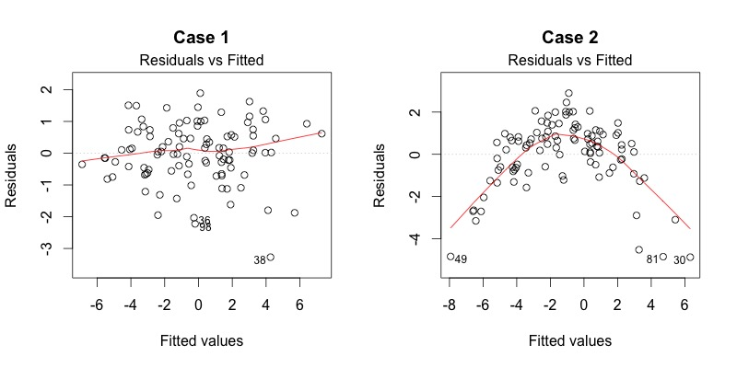
Supervised Machine Learning

Slide 11
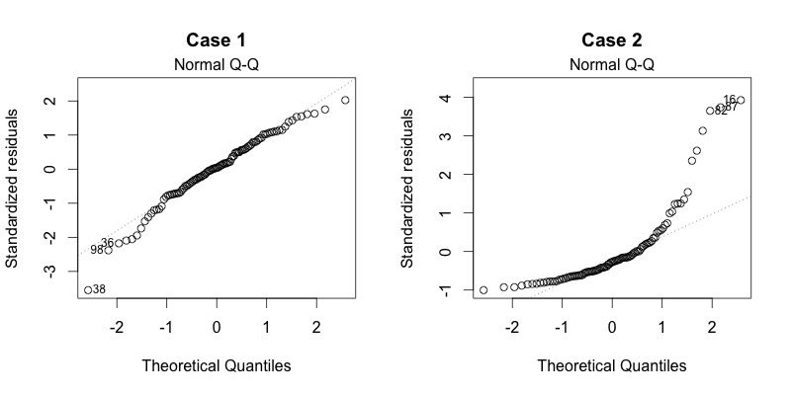
Supervised Machine Learning

Slide 12
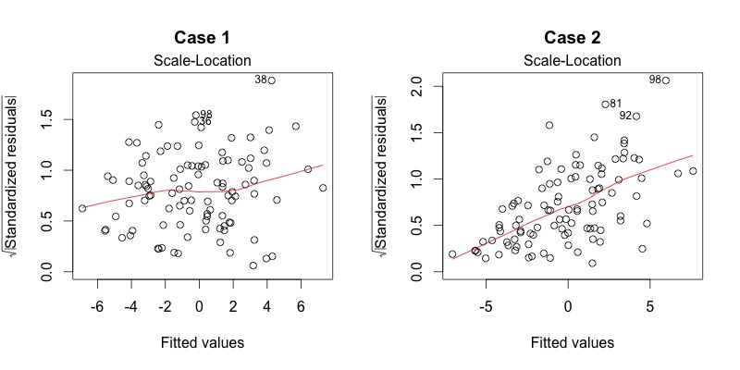
Supervised Machine Learning

Slide 13
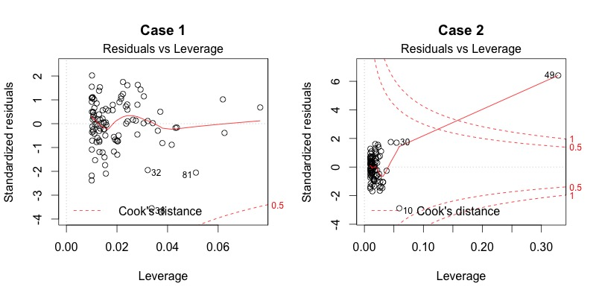
Supervised Machine Learning

Slide 14
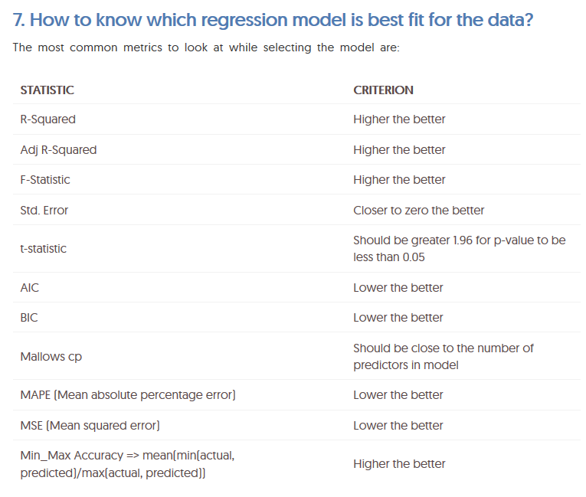
Supervised Machine Learning

Slide 15
Code modules
WEEK 9-1 Code module – EDA for simple regression
WEEK 9-2 Code module – Fit a linear model to make a prediction
WEEK 9-3 Code module – Residuals plot
WEEK 9-4 Code module – Create training and test set for multiple linear regression
WEEK 9-5 Code module – Fit a linear model
WEEK 9-6 Code module – Use trained model with the test set
Notes:
In order to demonstrate the concepts for WEEK 9, we’ll step through a series of in-depth R code examples found in the Code modules listed.
I encourage you to take the R script file for WEEK 9 and try each code snippet yourself. Take some time to tweak each example and try different things so you’ll fully understand each programming concept.

Slide 16
Summary
In WEEK 9 of Introduction to Data Science, we continued the data science process by exploring a popular supervised machine learning algorithm – linear regression.
We used the lm() algorithm for both simple and multiple linear regression.
We also saw useful plots to better understand the regression model.
We split the data set into a training set and test set to come up with a test set error metric to see how well our model generalizes.
Notes:
In WEEK 9 of Introduction to Data Science we continued the data science process by exploring a popular supervised machine learning algorithm – linear regression.
We used R’s lm() algorithm for both simple and multiple linear regression.
We used data visualization techniques to plot a regression line on top of a scatterplot and we also saw a residuals plot to see how closely the actual points were to the regression line.
Lastly, we saw experimented with a very important method in machine learning – splitting the data set into a training set and test set in order to calculate a test set error metric that tells us how well our model generalizes with new data.

